Slide 1





AI FOR
SUSTAINABILITY VIRTUAL INTERNSHIP

Slide 2

RAG
SMART WATER USAGE ADVISOR USING RETRIEVAL-AUGMENTED GENERATION
PRESENTED BY
G RAJASREE [2411021061124]
BAGEPALLI LAKSHMI PRIYA [2411021061128]
PALLAVI M [24110210611356]
DIVYA SHETTY [2411021061275]
College Name: ALLIANCE UNIVERSITY
Internship: 1M1B – AI for Sustainability Virtual Internship
SDG: SDG 6 – Clean Water and Sanitation

Slide 3
PROJECT DESCRIPTION
01
02
03
SDG ALIGNMENT
PROBLEM STATEMENT
  AI SOLUTION OVERVIEW
Primary SDG:
  SDG 6 – Clean Water and Sanitation
Secondary SDG:
  SDG 12 – Responsible Consumption and Production
Why SDG 6?
  Ensures availability and sustainable management of water
  Directly related to household and community water usage
Water is wasted due to:
  Lack of awareness
  Poor access to water conservation guidelines
  Difficulty understanding policy documents
Problem Statement:
How might we use AI to provide accurate and easy-to-understand water conservation guidance so that communities can reduce water wastage and adopt sustainable practices?
The Smart Water Usage Advisor is an AI-powered assistant that:
  Answers water-related questions
  Uses verified documents as its knowledge source
  Provides simple, factual, and reliable guidance
  Prevents misinformation through document-based responses
  Supports sustainable water usage practices
  .

Slide 4
PROJECT DESCRIPTION
04
05
06
  TARGET USERS
  RESPONSIBLE AI CONSIDERATIONS
  EXPECTED IMPACT
  Reduced water wastage in households and hostels
  Increased awareness of water conservation practices
  Improved access to reliable sustainability information
  Contribution towards achieving SDG 6 – Clean Water and Sanitation
  Students living in hostels
  Urban households
  Rural communities
  Apartment associations
  General public seeking water conservation guidance
  Fairness: Provides equal access to information for all users
  Transparency: Answers are generated using verified documents
  Ethics: Avoids misleading or harmful suggestions
  Privacy: No personal or sensitive data is collected

Slide 5

PROTOTYPE WORKFLOW
HOW THE SYSTEM WORKS
  User enters a water-related question
  The query is converted into an AI-readable format
  Relevant information is retrieved from verified documents
  Retrieved content is filtered for accuracy and relevance
  AI processes the retrieved information
  AI generates a clear and factual response
  Response is based only on document evidence
  Final answer is displayed to the user

Slide 6
ROLE OF AI (RAG)
WHAT IS RAG?
WHY RAG?
Retrieval-Augmented Generation combines:
  Information retrieval
  AI-based response generation
  Prevents false answers
  Uses trusted documents only
  Ensures transparency and responsibility

Slide 7
PROMPT WORKFLOW & RAG DEMO
PROMPT WORKFLOW
  User enters a water-usage related question
  Prompt is pre-processed by the AI agent
  Key intent and activity are identified
  Query is sent to the RAG system
  Context-aware prompt is generated
RAG DEMO
  User query triggers document retrieval
  Relevant water-conservation documents are fetched
  Retrieved content is combined with the user prompt
  AI generates an accurate, data-backed response
  Output is displayed in chat interface

Slide 8


AGENT LOGIC
  User submits a water-related query
  Agent identifies user intent
  Relevant documents retrieved using RAG
  Retrieved data is validated for accuracy
  AI generates responsible water-saving advice
  Final response shown to the user
SOURCES
DOCUMENT SOURCES
The AI system uses:
  Government water conservation guidelines
  Municipal water usage policies
  Rainwater harvesting manuals
  NGO sustainability reports

Slide 9
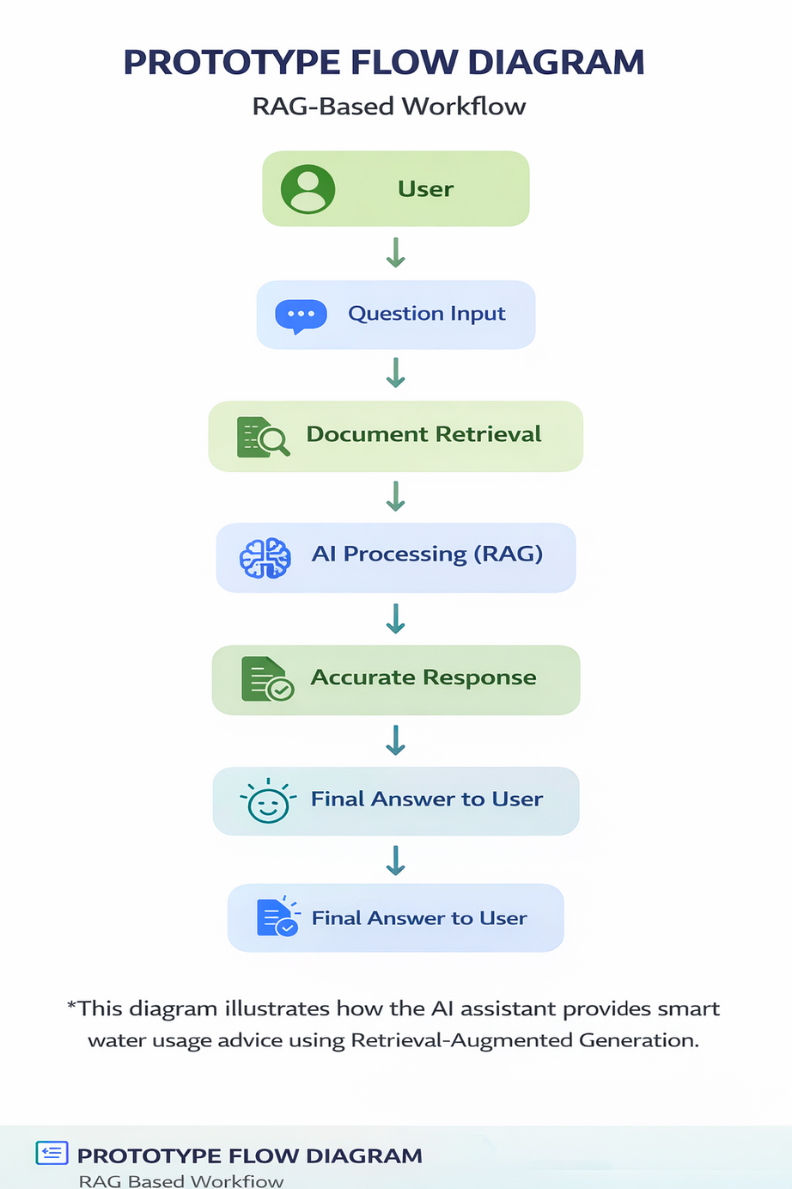
FLOW DIAGRAM
SAMPLE OUTPUT
  User asks a question
  AI processes the query
  Relevant documents are retrieved
  AI generates response using retrieved data
Accurate answer shown to user

Slide 10

IMPACT STATEMENT
WHAT CHANGES IF THIS SOLUTION IS IMPLEMENTED
01
  People become more conscious about water usage
  Daily water consumption reduces
  Communities adopt sustainable habits
WHO BENEFITS AND HOW?
  Individuals: Save water and reduce bills
  Communities: Better water availability
  Environment: Reduced stress on water resources
  Future generations: Sustainable water access
02

Slide 11

THANK YOU

